Slide 1



Improvement and change
Part of the DNA of Care Programme

Slide 2

Change in the NHS
‘There is nothing unusual about change in the NHS.
This doesn't mean change occurs naturally in the interest of patients. In fact, it requires a deliberate decision by those in the system to direct it.’
NHS Confederation, 2013
Photo © Pip Hardy

Slide 3

Dealing with change
‘I do not think you can really deal with change without a person asking real questions about who they are and how they belong in the world.’
David Whyte, 1998
Photo © Pip Hardy

Slide 4

The context of change
‘Cooperation requires all of us to face up to difficult questions about the demands we place on the system. We all bring our own concerns and worries to that discussion, but these anxieties are better considered collectively, rather than in isolation.’
NHS Confederation, 2013
Photo © Pip Hardy

Slide 5

Leading change
‘To deliver real improvements to
patient care, change
must be driven and encouraged from within.’ Christensen, 2009
Photo © Pip Hardy

Slide 6

Leading change
‘To deliver the changes that are needed to sustain and improve care, the NHS needs to move from pockets of innovation and isolated examples of good practice to system-wide improvement.’
Kings Fund, 2016
Photo © Pip Hardy

Slide 7

Sparks of change
‘More needs to be done to help people to nurture change sparks and bring about change’.
Kings Fund 2018
Photo © Pip Hardy

Slide 8

The DNA of Care
‘The intertwined relationship between patient care and staff well-being has been likened to the double helix. And so the stories we tell each other are like the DNA of care, transmitting information and shaping cultures, offering learning opportunities and, sometimes, healing.’
Pip Hardy and Tony Sumner, 2016

Slide 9
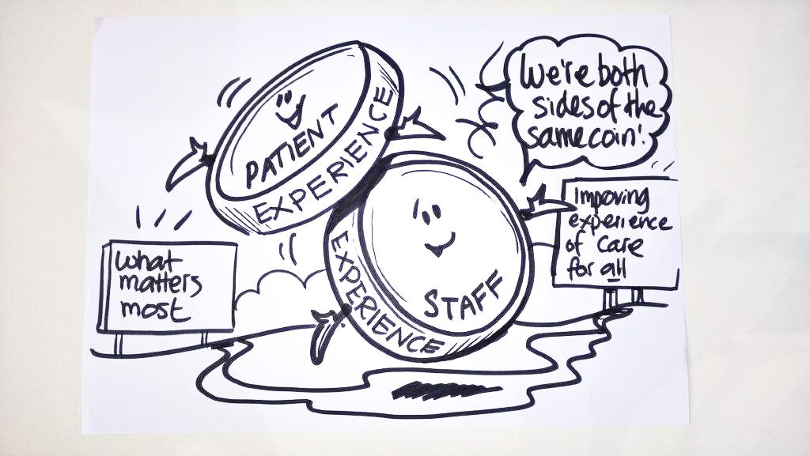
Two sides of the same coin
Staff experience drives patient experience.
‘Focusing on this relationship could be the most important move for the healthcare system to make.’
Karen Deeny, 2017

Slide 10
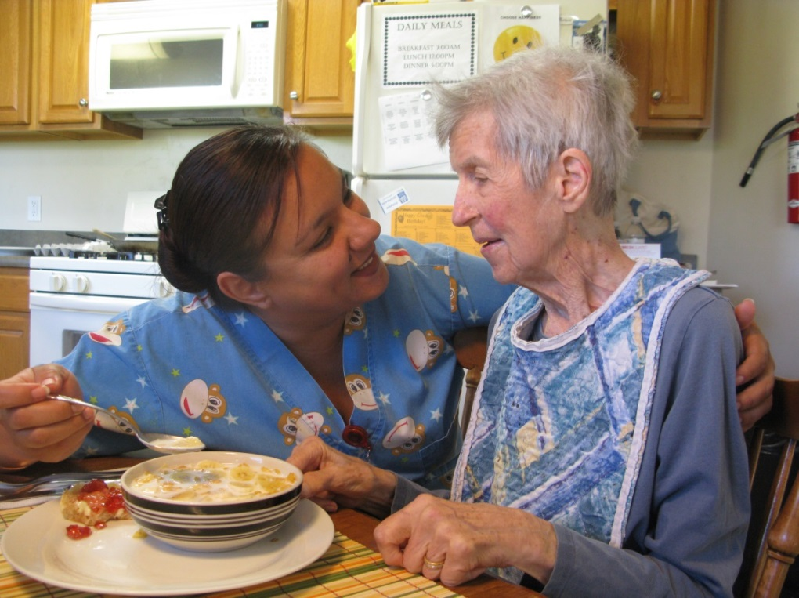
Compassion for everyone
‘Both staff and patients need care, compassion and respect.’
Professor Michael West 2014
Photo © Pip Hardy

Slide 11
DNA of Care stories of improvement and change
A little bit awkward
I’m sorry
Measuring what counts
Fixer

Slide 12

A little bit awkward
www.patientvoices.org.uk/flv/0995pv384s.htm Rebecca Lacey 2016

Slide 13

I’m sorry
www.patientvoices.org.uk/flv/0999pv384s.htm Sharon Knight 2016

Slide 14

Measuring what counts
www.patientvoices.org.uk/flv/1010pv384s.htm Richard Scott 2016

Slide 15
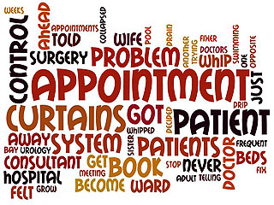
Fixer
www.patientvoices.org.uk/flv/1002pv384s.htm Fay Allen 2016

Slide 16
Questions for reflection
How far does ‘Measuring what counts’ capture and reflect some of the internal and external factors that motivate or limit our motivation to change and improve?
In which ways does ‘I’m sorry’ illustrate different perceptions of change?
How do these stories highlight and explore some of the ways in which people more meaningfully engage in changing and improving practice?

Slide 17
Questions for reflection
How might these stories help focus more attention of co-production and treating patients in the right way?
How can these stories support and illustrate the significance of change from within?
How can these stories support and illustrate the significance of change at all levels?
In which ways does ‘A little bit awkward’ highlight the pressures staff feel in leading improvement?

Slide 18
Questions for reflection
How can these stories support ‘sparks to become flames’ ?
What three things does xx story focus your attention on, in terms of what you (or we) should do next?
Having seen xx story, what is the one thing you feel compelled to do immediately?

